Slide 1
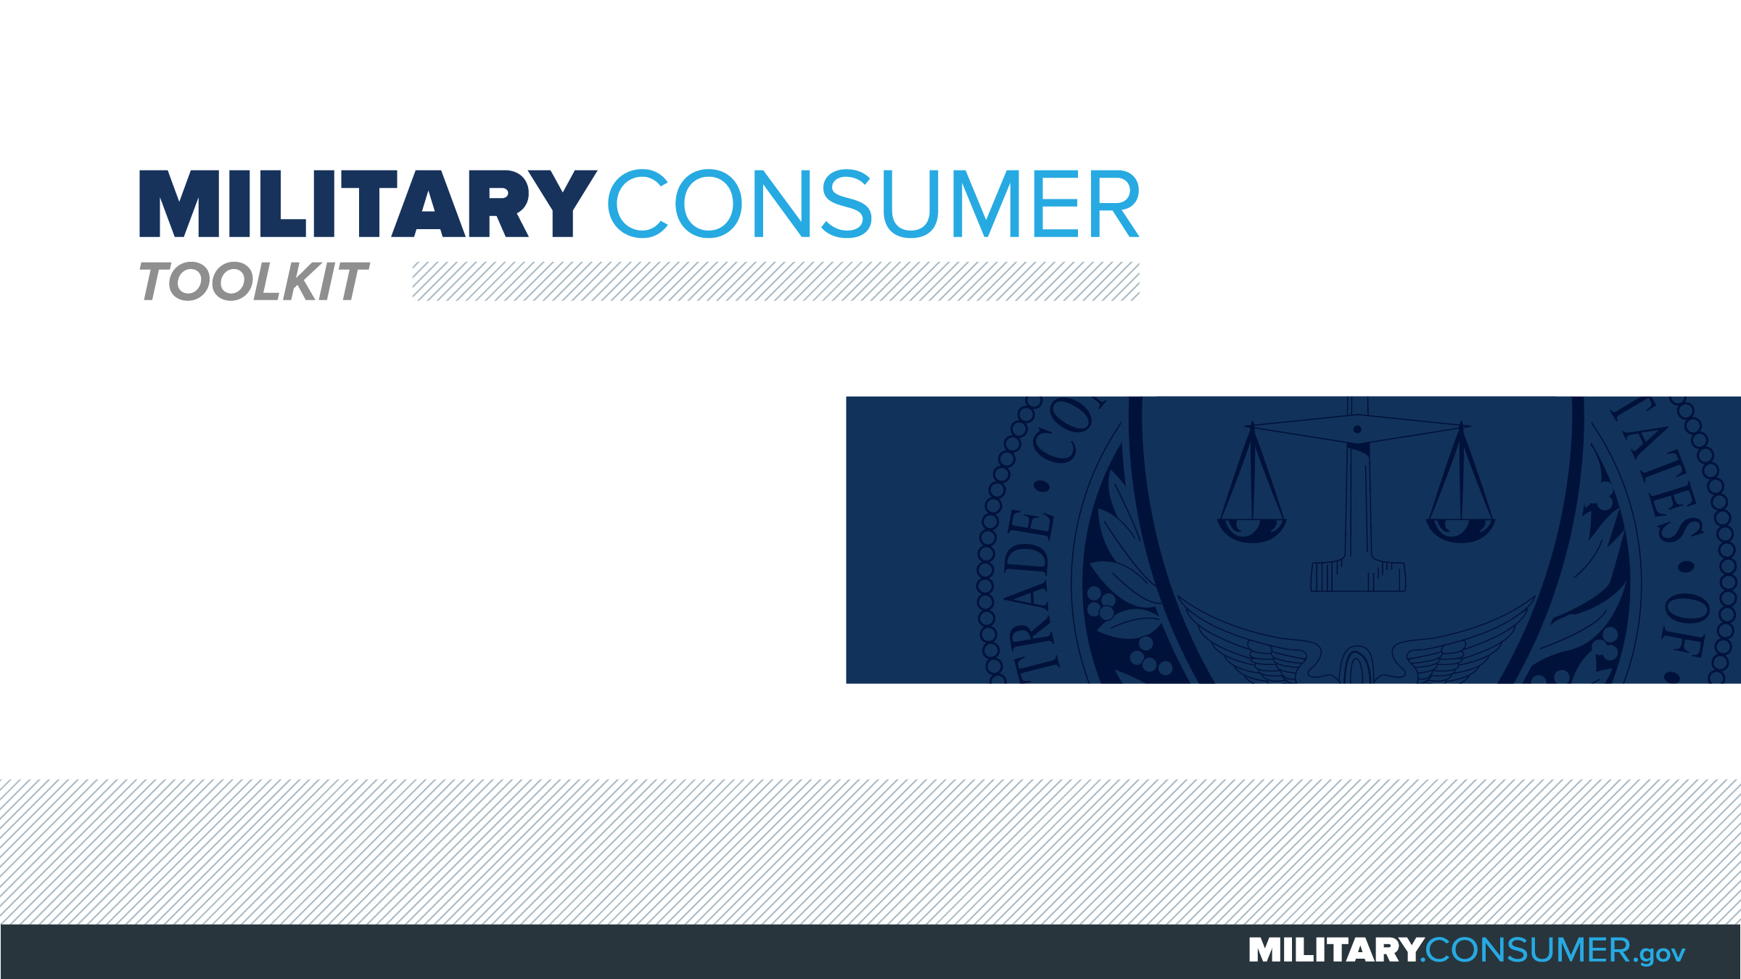

Slide 2

Why This Matters
Studies show that, on average, military families have higher amounts of debt and fewer assets than civilians
Challenges of military life can affect servicemembers’ finances:
  Frequent transition and changes
  Many servicemembers have little financial experience
  Decisions have long-term effects
Getting the know-how is key to making smart financial decisions
Notes:
[Presenter: Use this slide to set up the rest of your presentation, following it with slides that focus on the specific topics you want to cover.]
Suggested Script:
Today I’d like to talk about financial readiness – why it’s important and what you need to know to achieve it.
According to the National Foundation for Credit Counseling, active members of the military, veterans and their families have higher amounts of credit card debt and fewer assets than civilians. This means that military families are less equipped than their civilian counterparts to have the money they need for a secure future.
This is caused by many factors. As you know, military life is full of events and transitions, and each of these events brings the need to make important financial decisions. Unfortunately, many servicemembers – especially those without much financial experience – lack the information they need to make the right choices. This is particularly scary because many of these decisions can have long-term effects on a servicemember’s security clearance, mission readiness and family life.
Understanding your finances is your first line of defense. That’s why I’m here today – to help provide you with practical tips and information that will help you feel prepared to make these critical decisions.

Slide 3

Notes:
Suggested Script:
Being in the military means that you have unique experience and benefits available to you that can help boost your earnings potential.
Today, we will learn about [PRESENTER: CUSTOMIZE TO SUIT THE TOPICS YOU WILL COVER] earning money – specifically, how to find and pay for schooling, as well as what to know about making money.

Slide 4

Paying for Your Education
While in the service
  Tuition Assistance
  TA Decide - Dodmou.com/TADECIDE
  Voluntary Education Programs
  GI Bills
As you leave the service
  Transition Assistance Program
  State veterans’ benefits
  VA’s GI Bill Comparison Tool – Vets.gov/gi-bill-comparison-tool
  Scholarship info on Military OneSource
Notes:
Suggested Script:
There are numerous education benefits that can help you during your service or after you transition to civilian life. Understand what they are so you can put them to work for you.
While you are in the service, explore the following programs:
Your service’s Tuition Assistance program could pay for much or all of your costs.
DoD’s TA Decide program helps you compare schools to see if they accept your benefits.
Your service’s Voluntary Education contact can explain benefits, eligibility, funding and programs.
GI bill benefits – including post-9/11 GI Bill and Montgomery GI Bill – can be used while you are serving, but you may also want to save them for your transition or when you’re a veteran.
As you are planning to leave the service, check out the following:
The Transition Assistance Program prepares you and your family for pursing education, a job or business ownership as civilians.
State veterans’ affairs offices can explain what state benefits you are eligible for.
The VA’s GI Bill Comparison Tool tells you whether a school is approved for GI Bill benefits, how much they will cover and how much you’ll need to pay.
MilitaryOneSource can be a great place to find information about scholarships. Beware of companies that guarantee they can get you a scholarship in exchange for an up-front fee – most are scams.

Slide 5
Paying for Your Education
Student loan basics
  Supplement GI Bill benefits
  Lifetime cap
  Must repay even if you don’t finish
  Federal loans: better rates than private loans
  StudentAid.gov
Before you commit
  What’s the interest rate and the total cost?
  When repayment begin and how often will you pay?
  How long do you have to repay?
Notes:
Suggested Script:
Federal student loans can be used to supplement your GI Bill benefits and cover costs. Some important things to know about student loans include:
There’s a lifetime cap on the total amount of federal student loans you can take. Once you hit it, you can still get private loans, but those are usually more expensive.
For all loans, you must repay them even if you do not finish school.
Federal student loans typically offer better rates than private loans.
For more information about federal loans, grants and scholarships, visit www.studentaid.gov.
Before you commit to a student loan, make sure you understand what you’re getting in to. Start by talking to the school’s financial aid office to make sure you know the program’s total cost and how often you will need to pay. This could be by the course, semester or the full program.
Then, make sure you understand how much you’re borrowing and the interest rate, when repayment will begin and how much time you will have to repay the loan.
Discussion Question:
Which do you think is a better option, a federal student loan or a private one? Why?

Slide 6


