Slide 1
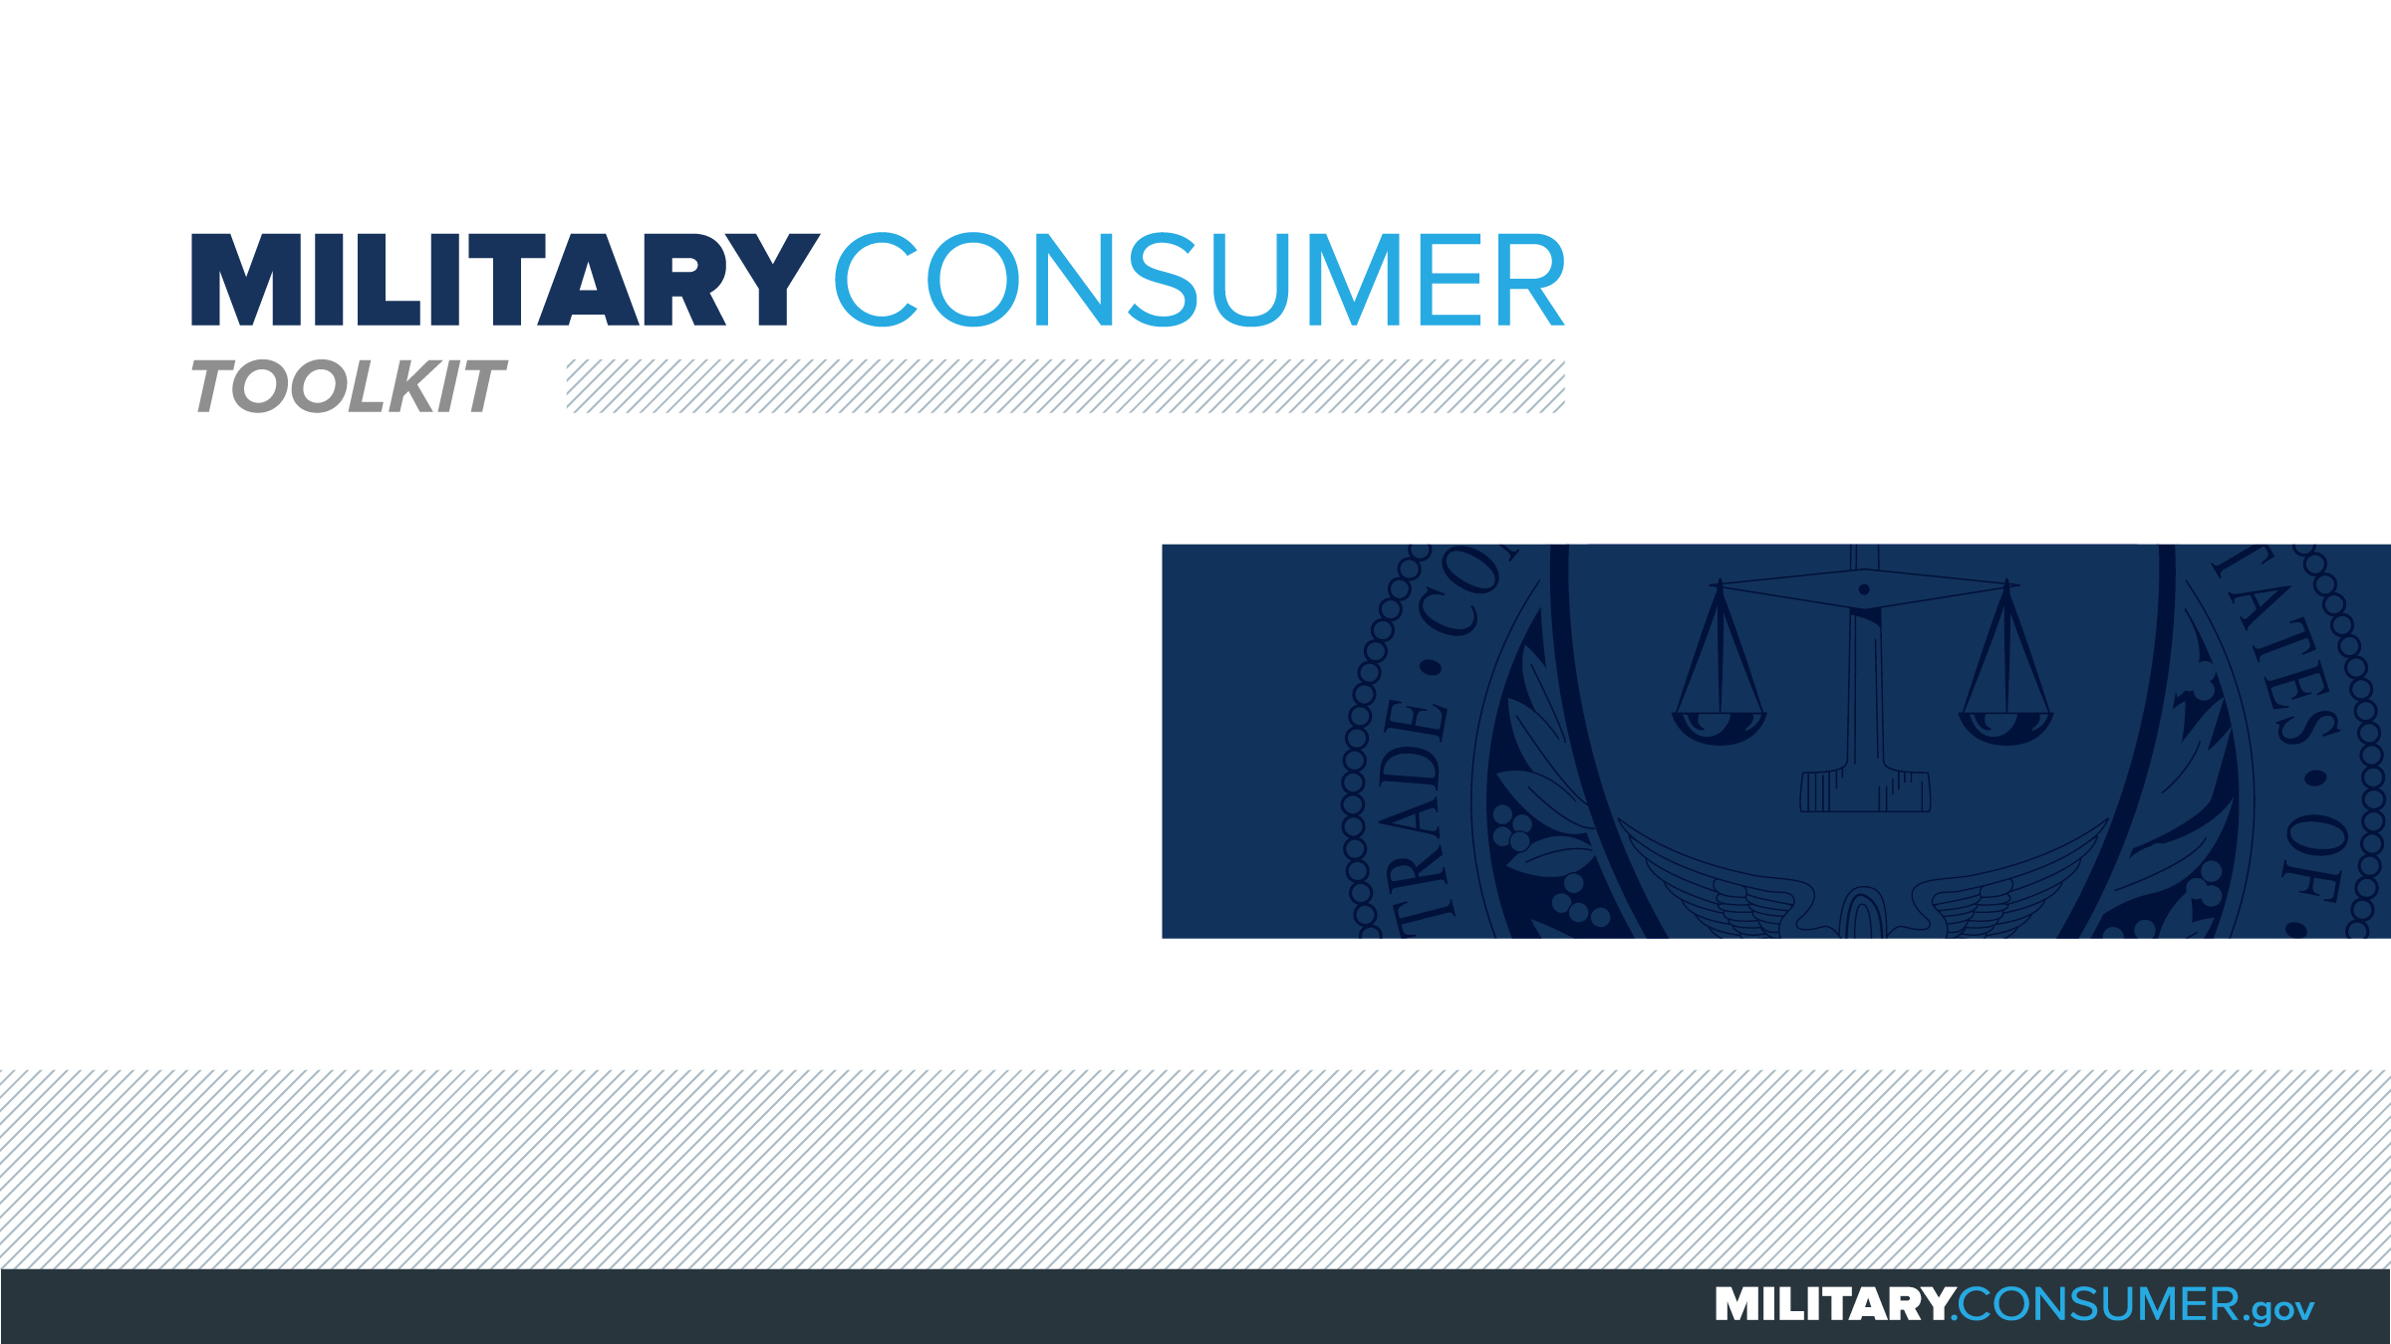

Slide 2
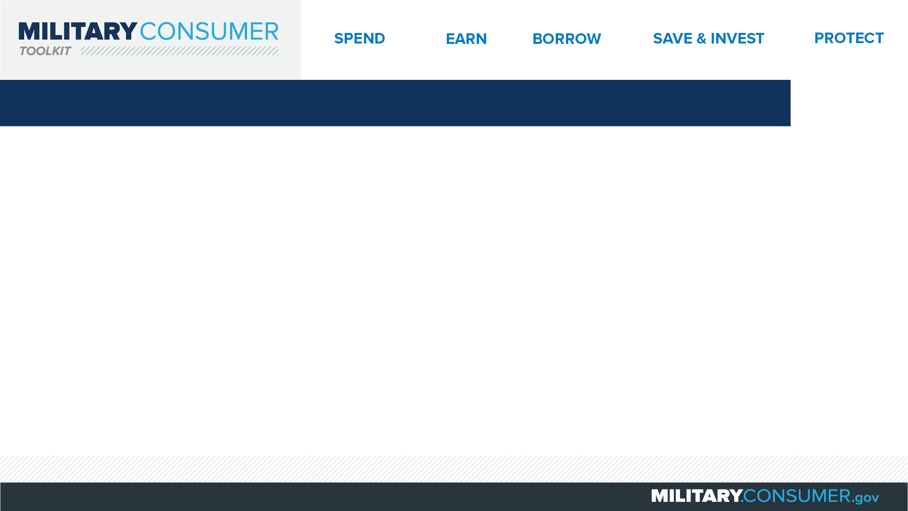
Why This Matters
Studies show that, on average, military families have higher amounts of debt and fewer assets than civilians
Challenges of military life can affect servicemembers’ finances:
  Frequent transition and changes
  Many servicemembers have little financial experience
  Decisions have long-term effects
Getting the know-how is key to making smart financial decisions
Notes:
[Presenter: Use this slide to set up the rest of your presentation, following it with slides that focus on the specific topics you want to cover.]
Suggested Script:
Today I’d like to talk about financial readiness – why it’s important and what you need to know to achieve it.
According to the National Foundation for Credit Counseling, active members of the military, veterans and their families have higher amounts of credit card debt and fewer assets than civilians. This means that military families are less equipped than their civilian counterparts to have the money they need for a secure future.
This is caused by many factors. As you know, military life is full of events and transitions, and each of these events brings the need to make important financial decisions. Unfortunately, many servicemembers – especially those without much financial experience – lack the information they need to make the right choices. This is particularly scary because many of these decisions can have long-term effects on a servicemember’s security clearance, mission readiness and family life.
Understanding your finances is your first line of defense. That’s why I’m here today – to help provide you with practical tips and information that will help you feel prepared to make these critical decisions.

Slide 3
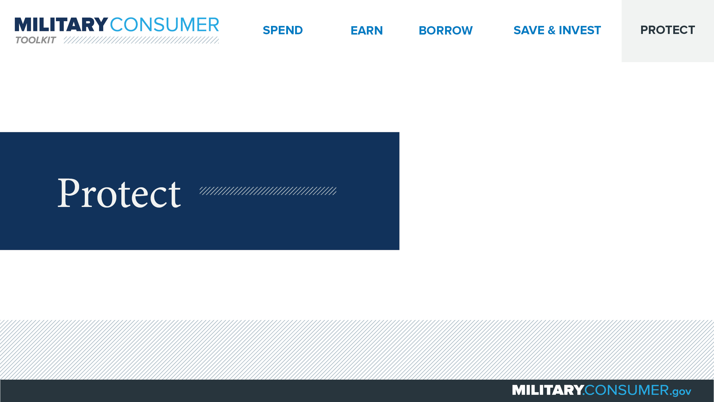
Notes:
Suggested Script:
With your financial situation in order, the last thing you want to do is have it be jeopardized by thieves and scammers.
Today, we’ll learn some actionable tips for keeping your finances safe, including [PRESENTER: CUSTOMIZE TO SUIT THE TOPICS YOU WILL COVER] how to safeguard your money, personal information, financial records and reputation.

Slide 4
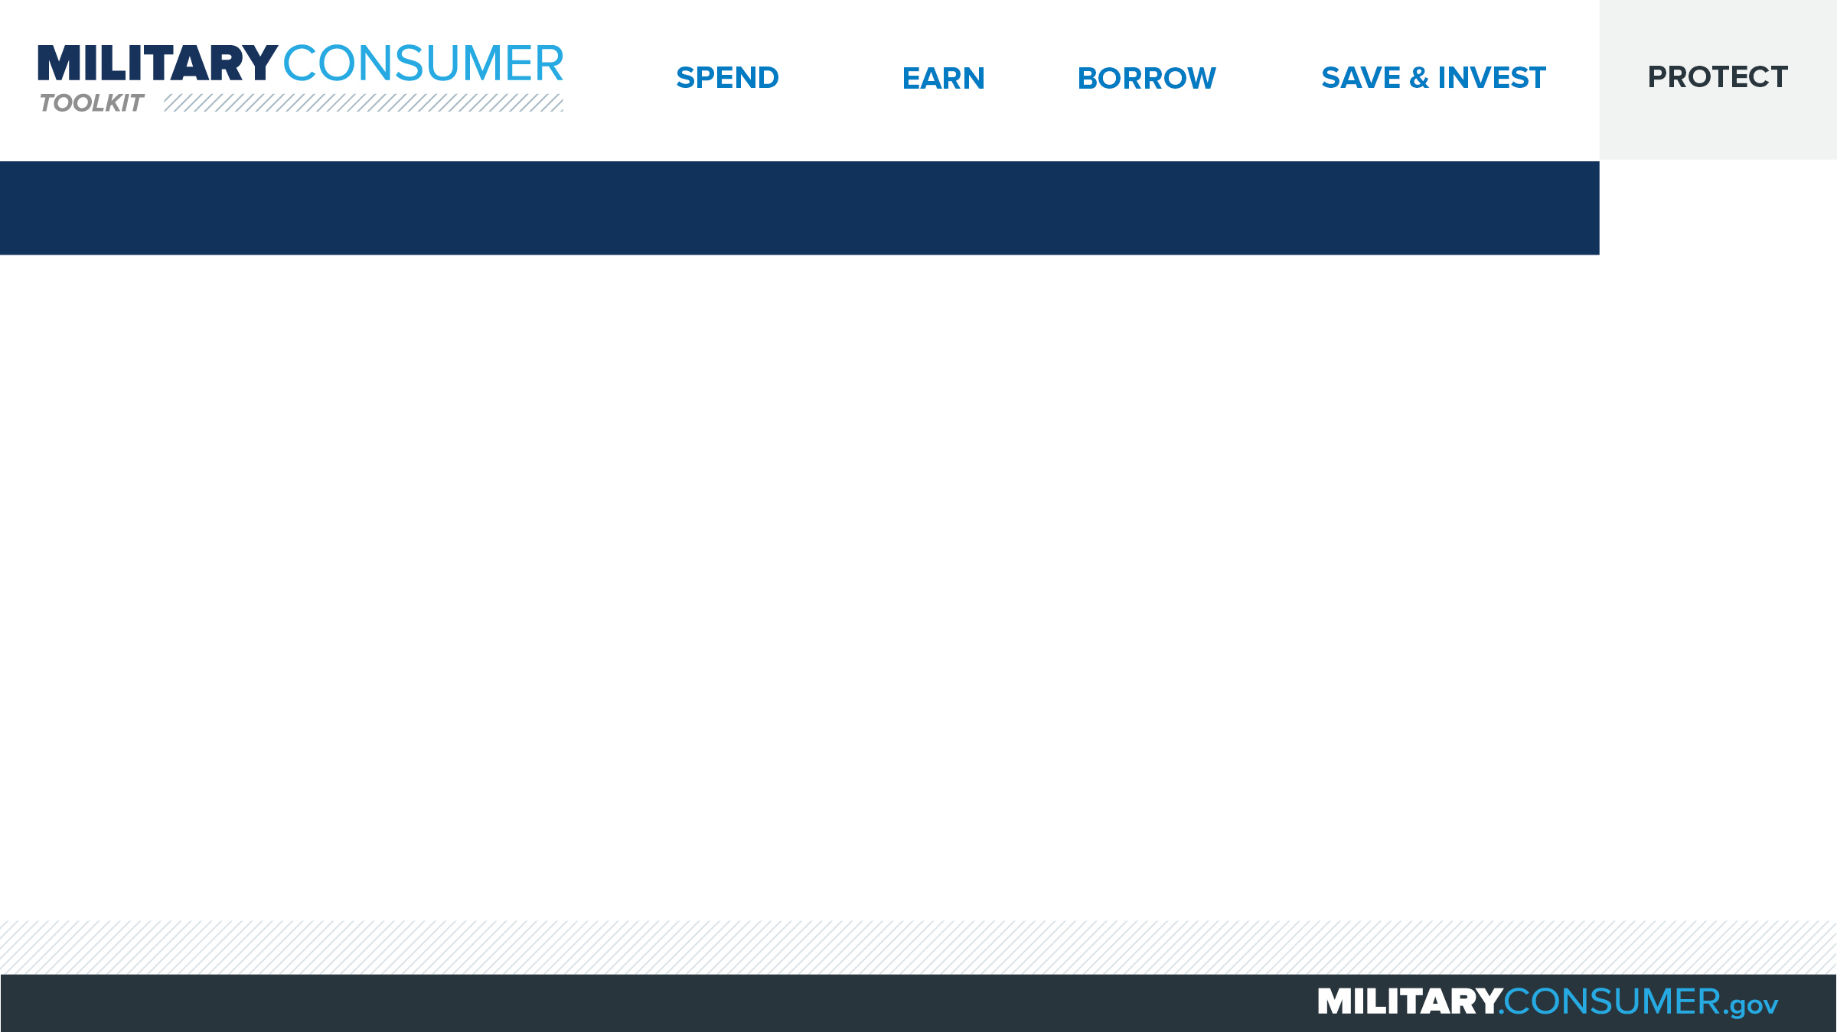
Responding to Identity Theft
Minimize the impact
  Call the companies where you know fraud occurred.
  Visit IdentityTheft.gov
  Place fraud alert
  Get credit report
  Notify your commanding officer
Notes:
Suggested Script:
Identity theft can disrupt your life, wreck your finances and even lead to the loss of your security clearance. If you are the victim of identity theft, here are five helpful tips to help you act quickly and minimize the consequences.
First, call the companies where you know fraud occurred. Ask them to close or freeze those accounts because your identity was stolen. If you have online account access, change your logins, passwords and PINs.
Visit IdentityTheft.gov or call 1-877-438-4388 to report the fraud and create your personal recovery plan. Create an account so you can track your progress.
Contact one of the three credit bureaus to place a fraud alert. That credit bureau will contact the other two to alert them and request that they create alerts. You should receive a letter from each of the three credit bureaus confirming this has been completed on your behalf.
Experian: Experian.com/fraudalert, 1-888-397-3742
TransUnion: TransUnion.com/fraud, 1-800-680-7289
Equifax: Equifax.com/creditreportassistance, 1-888-766-0008
Get your credit report and review it carefully to determine whether there are other accounts or concerning items.
Notify your commanding officer to alert him/her to the fraud. You don’t want him or her to be caught off guard by calls trying to collect on debts that aren’t yours.

Slide 5


