Slide 1
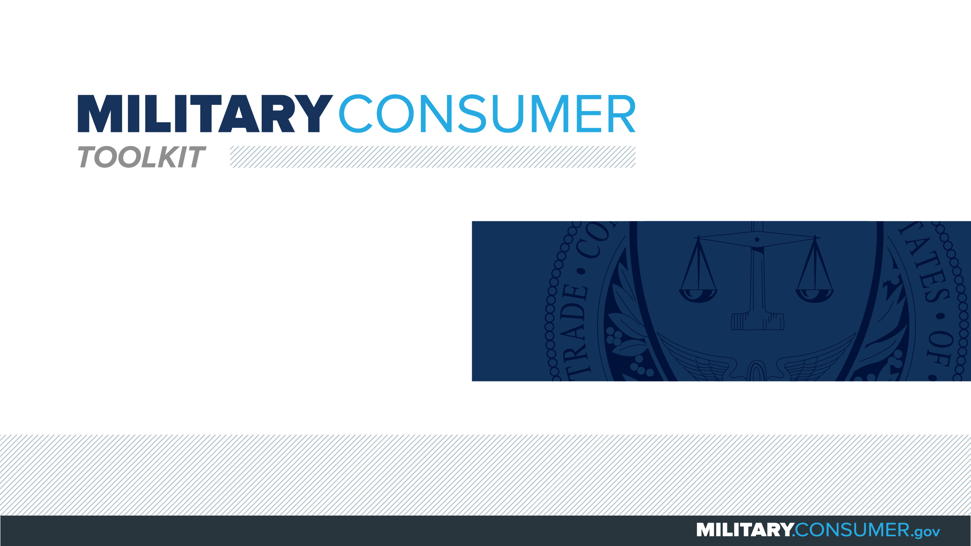

Slide 2
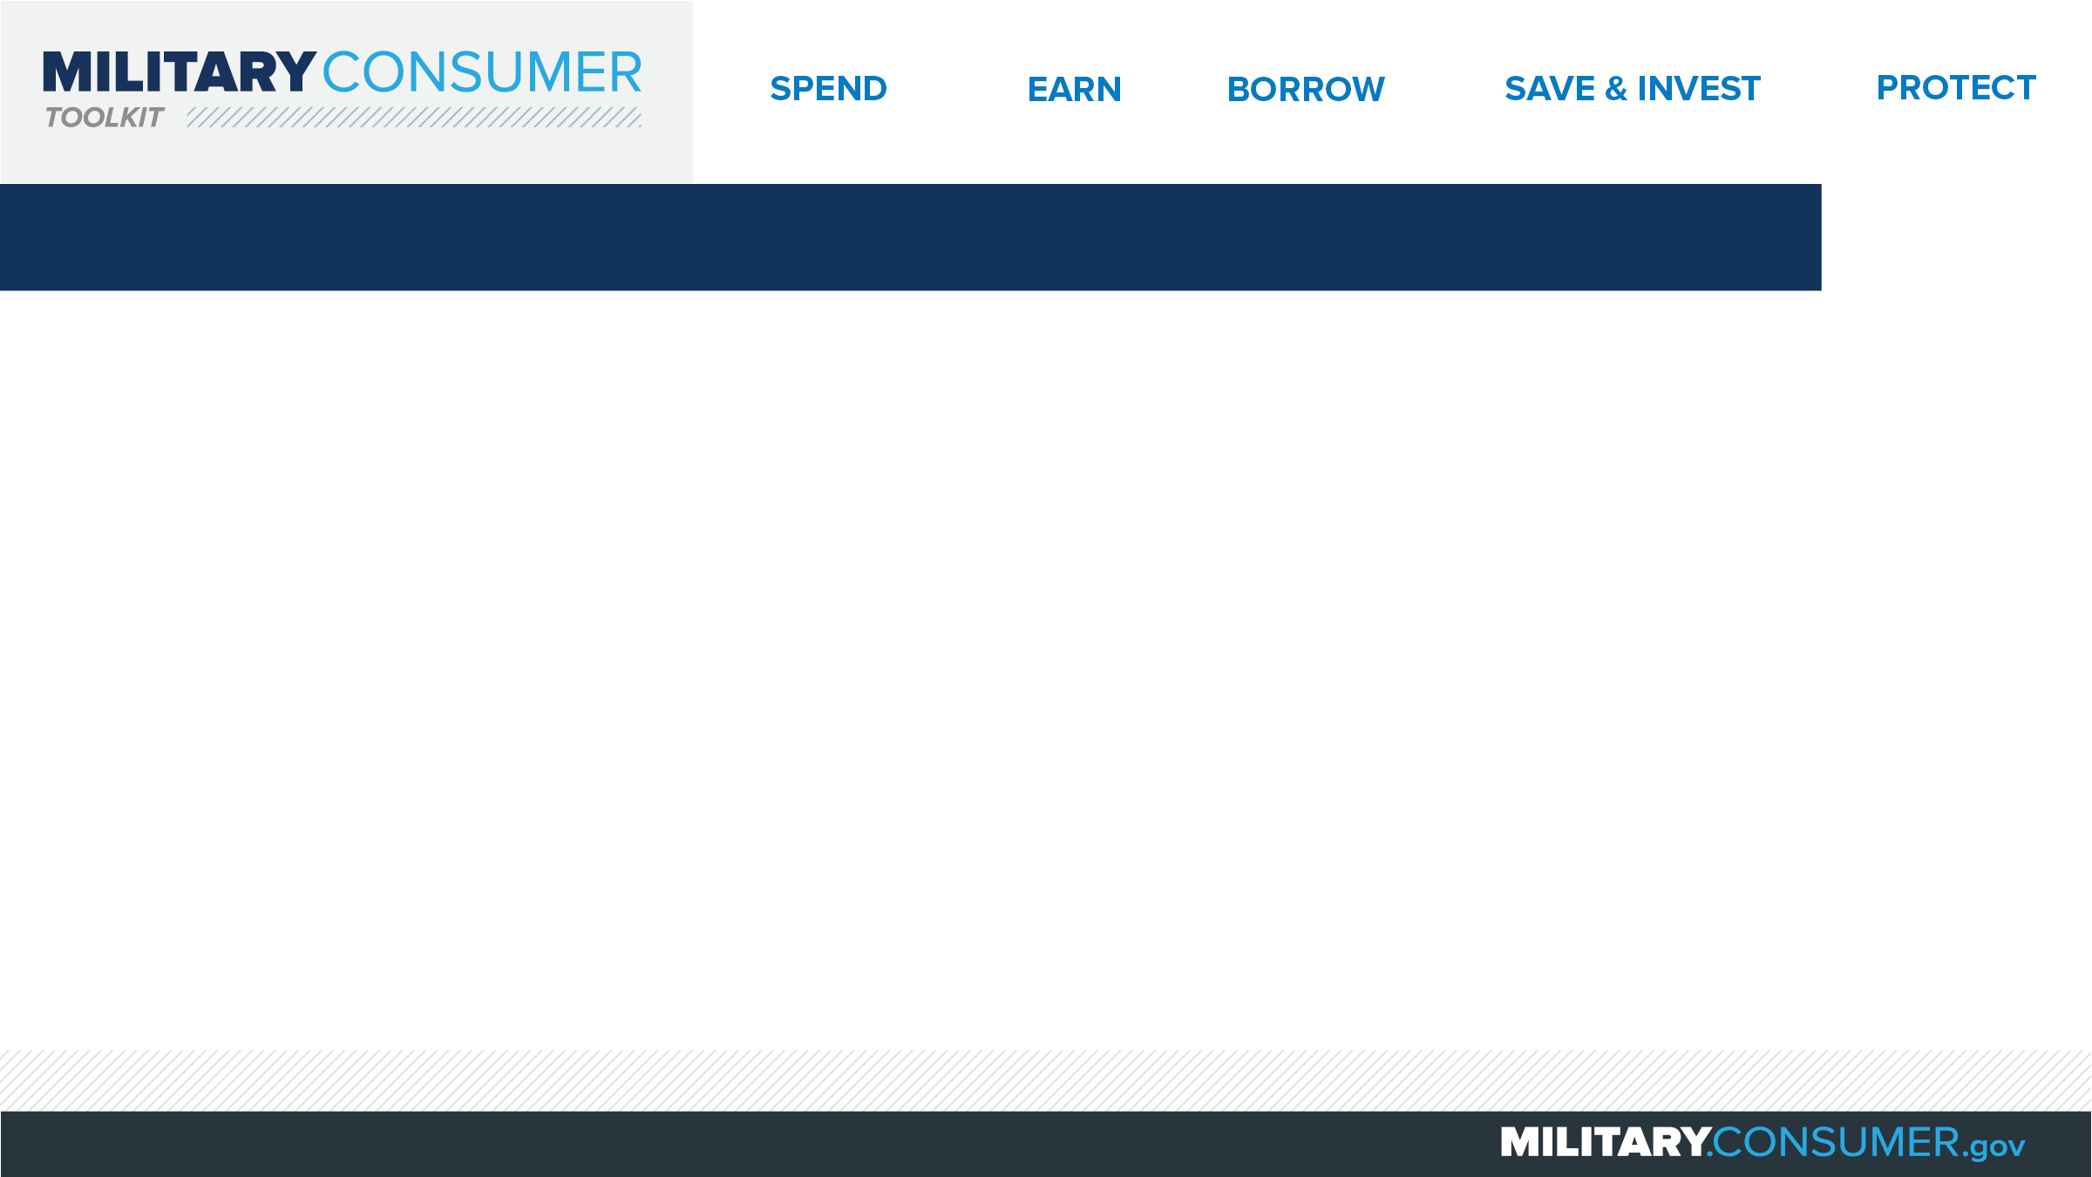
Why This Matters
Studies show that, on average, military families have higher amounts of debt and fewer assets than civilians
Challenges of military life can affect servicemembers’ finances:
  Frequent transition and changes
  Many servicemembers have little financial experience
  Decisions have long-term effects
Getting the know-how is key to making smart financial decisions
Notes:
[Presenter: Use this slide to set up the rest of your presentation, following it with slides that focus on the specific topics you want to cover.]
Suggested Script:
Today I’d like to talk about financial readiness – why it’s important and what you need to know to achieve it.
According to the National Foundation for Credit Counseling, active members of the military, veterans and their families have higher amounts of credit card debt and fewer assets than civilians. This means that military families are less equipped than their civilian counterparts to have the money they need for a secure future.
This is caused by many factors. As you know, military life is full of events and transitions, and each of these events brings the need to make important financial decisions. Unfortunately, many servicemembers – especially those without much financial experience – lack the information they need to make the right choices. This is particularly scary because many of these decisions can have long-term effects on a servicemember’s security clearance, mission readiness and family life.
Understanding your finances is your first line of defense. That’s why I’m here today – to help provide you with practical tips and information that will help you feel prepared to make these critical decisions.

Slide 3
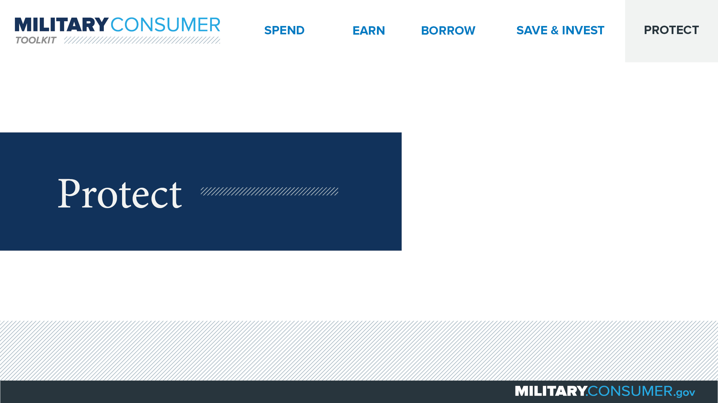
Notes:
Suggested Script:
With your financial situation in order, the last thing you want to do is have it be jeopardized by thieves and scammers.
Today, we’ll learn some actionable tips for keeping your finances safe, including [PRESENTER: CUSTOMIZE TO SUIT THE TOPICS YOU WILL COVER] how to safeguard your money, personal information, financial records and reputation.

Slide 4

Seeing Through Imposter Scams
Imposter scams
  Appear to come from someone you know
  Pressure you to send money quickly
Common versions
  Distressed friend/family in need
  IRS call
  “Free” money from government
  Computer virus alert
  Online dating interest requesting money
Notes:
Suggested Script:
Imposters impersonate someone you trust and pressure you to send money quickly. These requests can come by text, phone or email. No matter what, never send money or give personal information in response to an unexpected request.
Some of the most common imposter scams include:
In one, a distressed friend or family member calls you in urgent need of money. If this happens, do your research to make sure the emergency is legitimate. Scammers can hack into loved one’s email addresses or use information available on social networking sites to convince you the ask is real.
In another, the IRS calls to tell you you have outstanding debt. Remember, the IRS will never contact you first by phone or ask for payments via prepaid debit cards, iTunes cards, wire transfers. They will also never ask for credit card payment by phone. When in doubt, visit IRS.gov or call 1-800-829-1040.
The government calls you to tell you you’re going to get money or a grant. But really, a legit government agency won’t ask you to pay a professing fee related to forms like the FAFSA or for a grant that you have already been awarded.
In this scam, you receive a call saying that your computer has a virus and the person calling can help. Don’t fall for it – never give control of your computer or your credit card to someone calling you unexpectedly.
In this final common scam, a person you’ve been talking to through an online dating site starts asking for money. Beware – scammers of all genders make fake dating profiles to build relationships and scam innocent people out of money.

Slide 5


