Slide 1
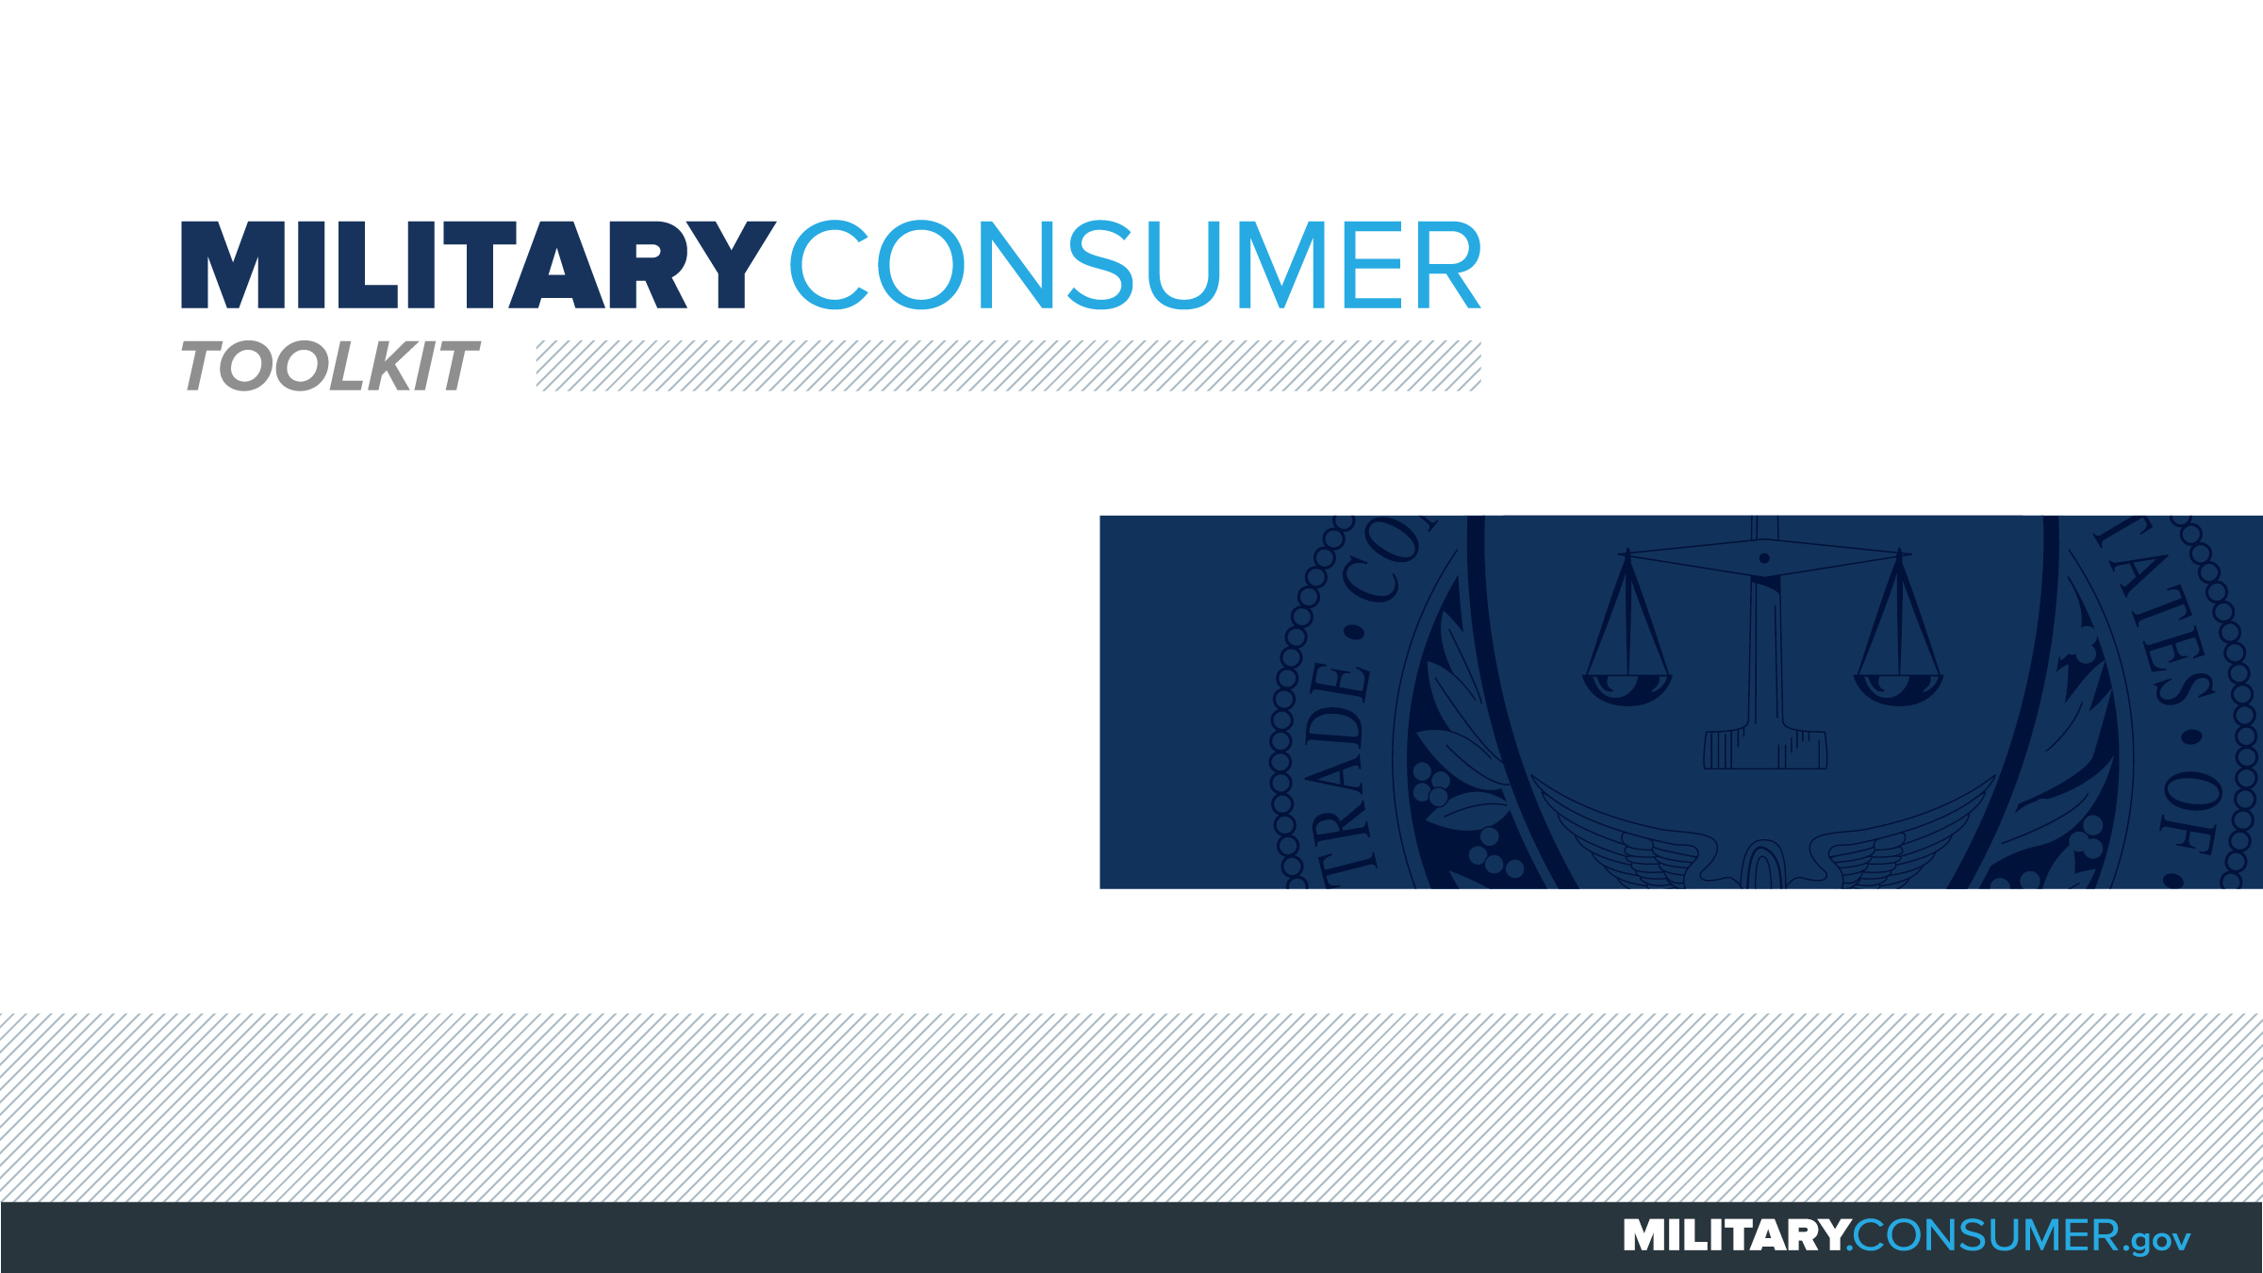

Slide 2
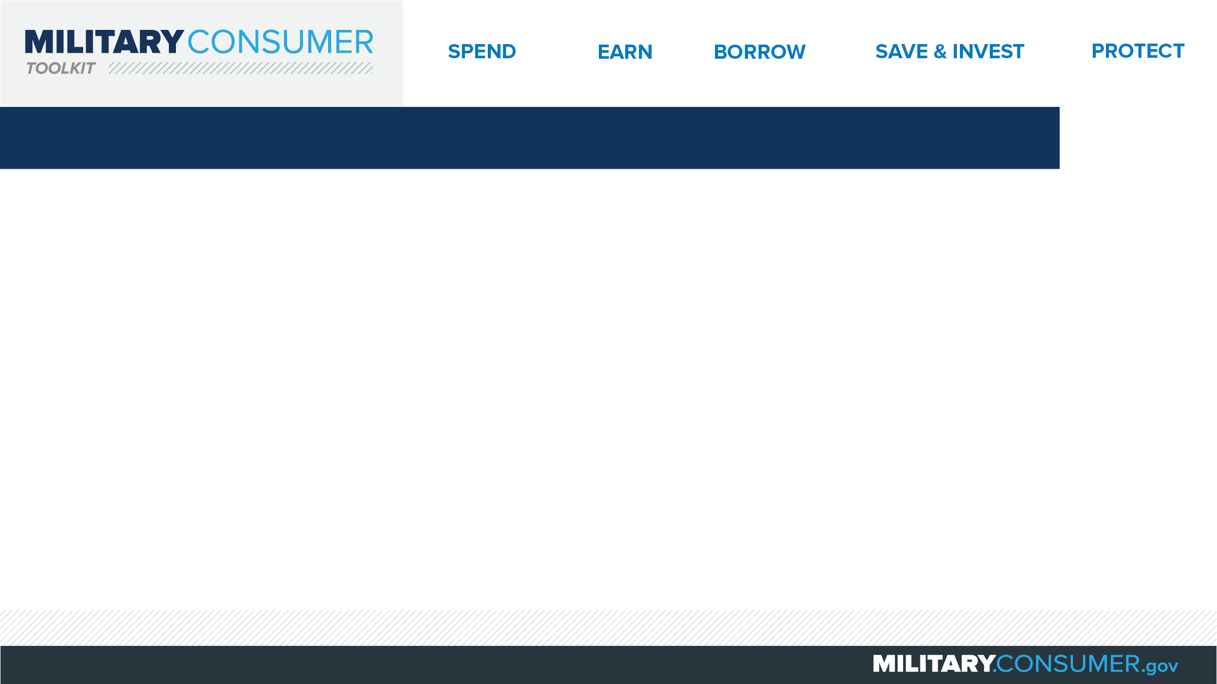
Why This Matters
Studies show that, on average, military families have higher amounts of debt and fewer assets than civilians
Challenges of military life can affect servicemembers’ finances:
  Frequent transition and changes
  Many servicemembers have little financial experience
  Decisions have long-term effects
Getting the know-how is key to making smart financial decisions
Notes:
[Presenter: Use this slide to set up the rest of your presentation, following it with slides that focus on the specific topics you want to cover.]
Suggested Script:
Today I’d like to talk about financial readiness – why it’s important and what you need to know to achieve it.
According to the National Foundation for Credit Counseling, active members of the military, veterans and their families have higher amounts of credit card debt and fewer assets than civilians. This means that military families are less equipped than their civilian counterparts to have the money they need for a secure future.
This is caused by many factors. As you know, military life is full of events and transitions, and each of these events brings the need to make important financial decisions. Unfortunately, many servicemembers – especially those without much financial experience – lack the information they need to make the right choices. This is particularly scary because many of these decisions can have long-term effects on a servicemember’s security clearance, mission readiness and family life.
Understanding your finances is your first line of defense. That’s why I’m here today – to help provide you with practical tips and information that will help you feel prepared to make these critical decisions.

Slide 3
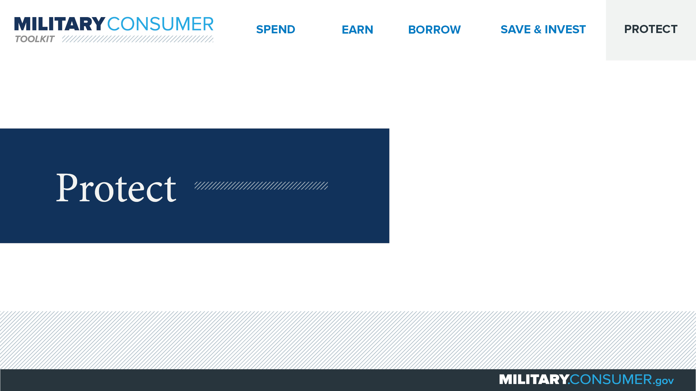
Notes:
Suggested Script:
With your financial situation in order, the last thing you want to do is have it be jeopardized by thieves and scammers.
Today, we’ll learn some actionable tips for keeping your finances safe, including [PRESENTER: CUSTOMIZE TO SUIT THE TOPICS YOU WILL COVER] how to safeguard your money, personal information, financial records and reputation.

Slide 4
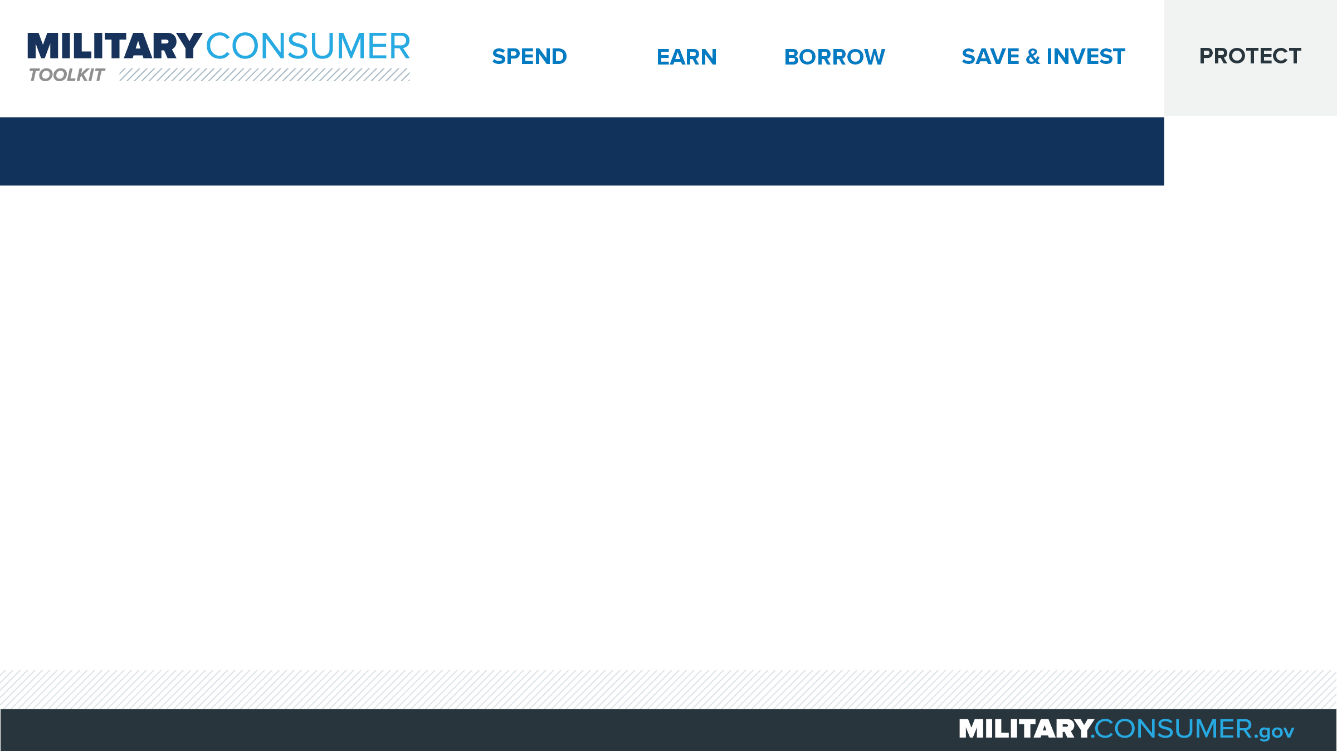
Ways to Avoid Scams
Beware of people or companies that:
  Ask for money, personal info
  Use recorded sales pitches
  Request payment via wire services, reloadable cards
  Ask you to deposit a check, wire money back
Stop and check it out
  Search online
  Talk to someone you trust
The FTC can help
  Free scam alerts
  Report scams
Notes:
Suggested Script:
Have you or someone you know ever fallen victim to a scam? It’s more common than you think. Although scam artists defraud millions of people ever year, avoiding fraud is within your control if you remember these helpful tips.
Beware of any individuals or companies that:
Call asking for money or personal information. Hang up immediately, and don’t rely on Caller ID to identify suspicious callers. It’s easily faked.
Use recorded sales pitches or “robocalls,” which are illegal.
Request payment via wire services or reloadable payment cards, neither of which offer a way to get your money back if it’s a scam.
Ask you to deposit a check and wire money back. If the deposited check turns out to be a fake, you will be expected to repay the bank.
Even though the caller may be pressuring you, stop and take the time to research any company or product before you buy.
Search for a company or product name online along with words like “review,” “complaint” or “scam” to uncover previous scam activity.
Also, talk to someone you trust to get their opinion.
The Federal Trade Commission is here to help.
Sign up for free scam alerts – http://www.ftc.gov/subscribe
Report scams – http://www.ftc.gov/complaint

Slide 5


