Slide 1
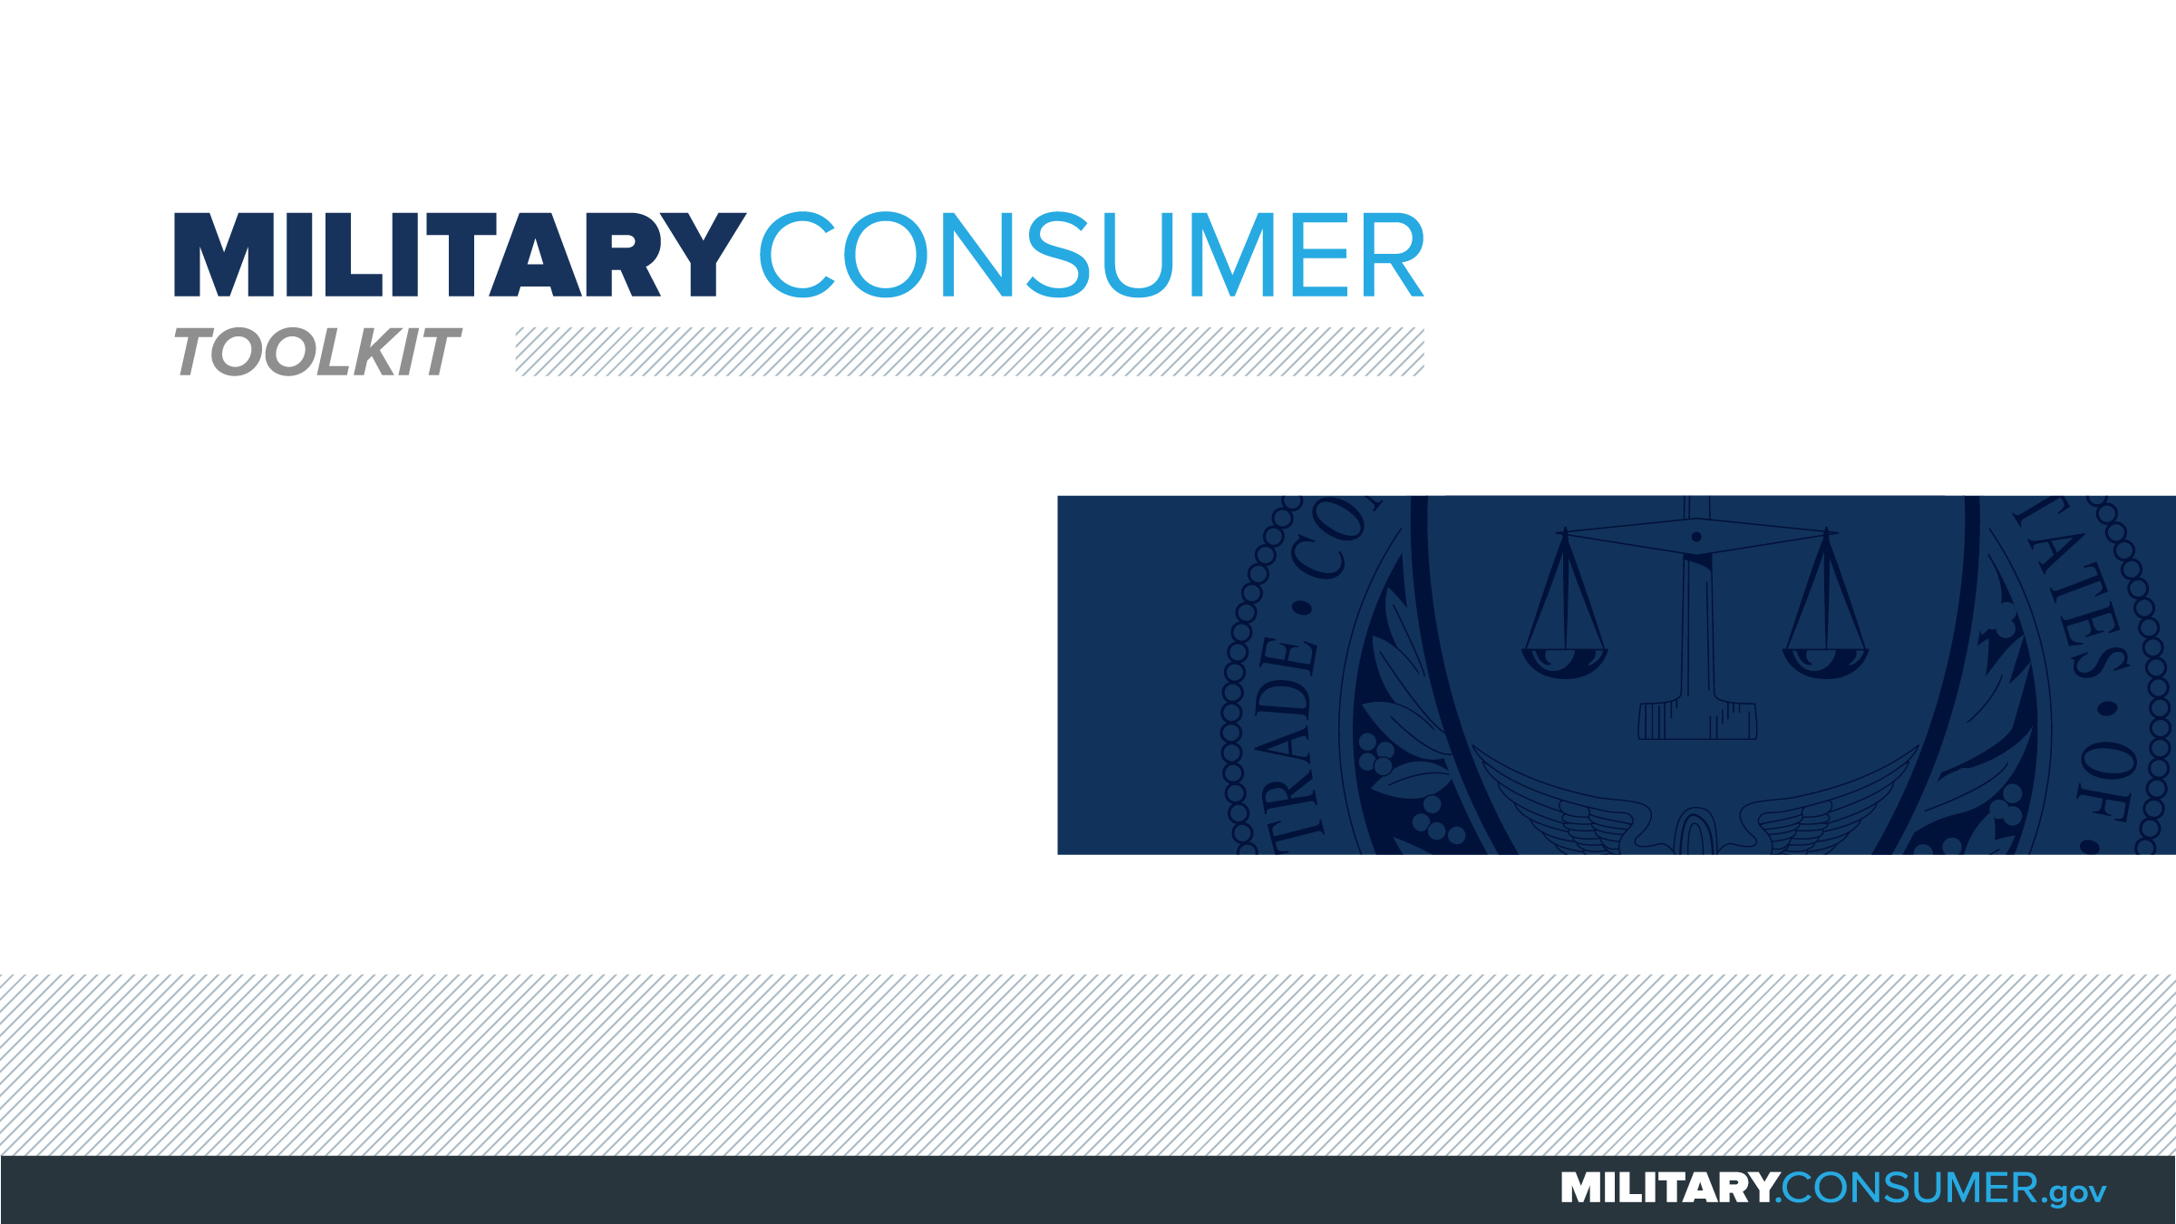

Slide 2
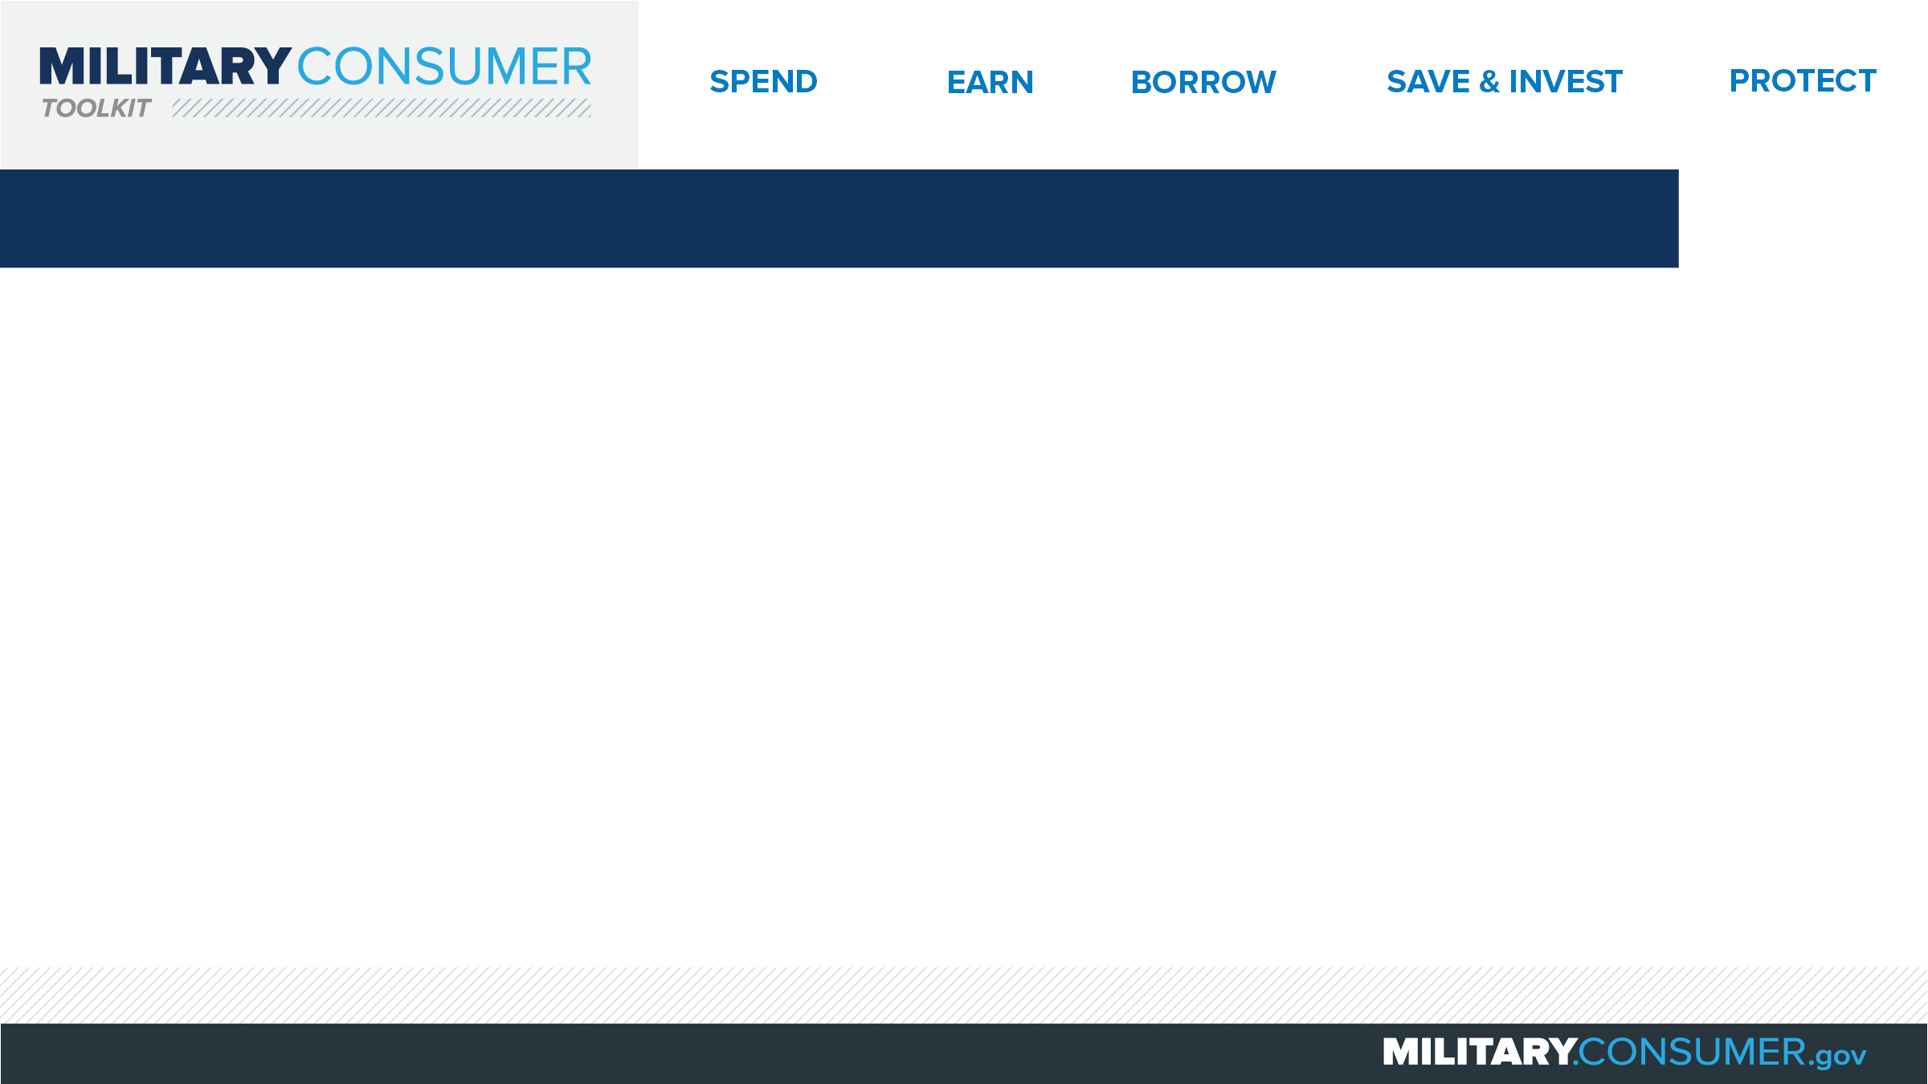
Why This Matters
Studies show that, on average, military families have higher amounts of debt and fewer assets than civilians
Challenges of military life can affect servicemembers’ finances:
  Frequent transition and changes
  Many servicemembers have little financial experience
  Decisions have long-term effects
Getting the know-how is key to making smart financial decisions
Notes:
[Presenter: Use this slide to set up the rest of your presentation, following it with slides that focus on the specific topics you want to cover.]
Suggested Script:
Today I’d like to talk about financial readiness – why it’s important and what you need to know to achieve it.
According to the National Foundation for Credit Counseling, active members of the military, veterans and their families have higher amounts of credit card debt and fewer assets than civilians. This means that military families are less equipped than their civilian counterparts to have the money they need for a secure future.
This is caused by many factors. As you know, military life is full of events and transitions, and each of these events brings the need to make important financial decisions. Unfortunately, many servicemembers – especially those without much financial experience – lack the information they need to make the right choices. This is particularly scary because many of these decisions can have long-term effects on a servicemember’s security clearance, mission readiness and family life.
Understanding your finances is your first line of defense. That’s why I’m here today – to help provide you with practical tips and information that will help you feel prepared to make these critical decisions.

Slide 3
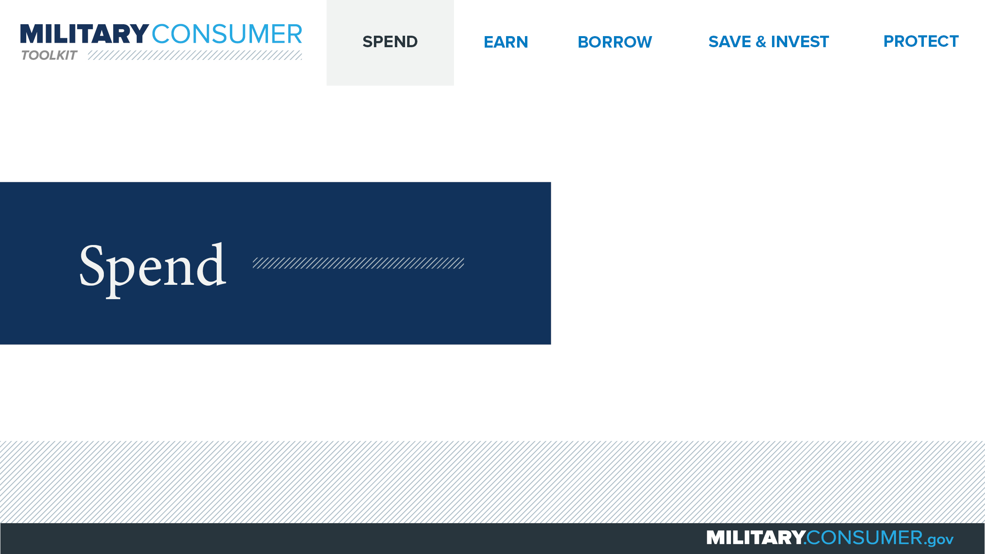
Notes:
Suggested Script:
Spending money is a fact of life. But it’s best to do this in a way that is carefully researched and planned out. When you know where your money is going, you have the power.
Today, we will learn about [PRESENTER: CUSTOMIZE TO SUIT THE TOPICS YOU WILL COVER] people who are available to help you plan your spending, how to create and manage a budget and how to shop smart for purchases ranging from small to large.

Slide 4
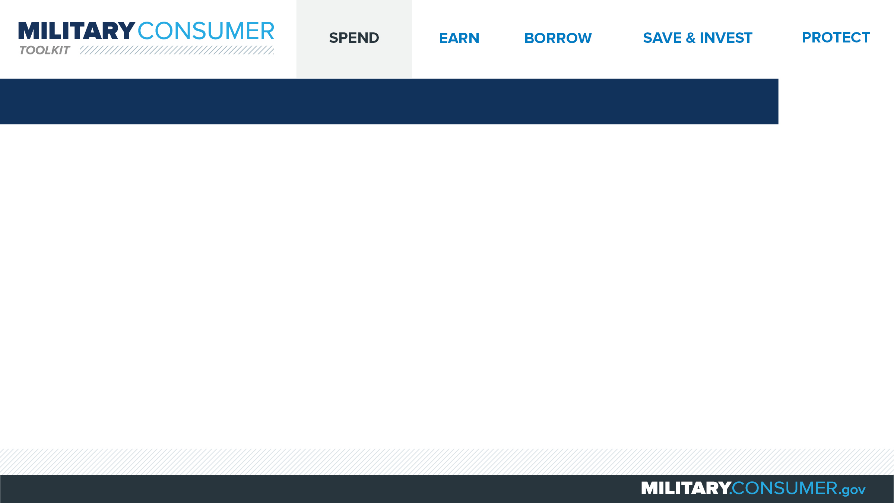
Buying a Home
Pros and cons
  Renting – you can move at a moment’s notice
  Buying – you owe mortgage payments until you sell, even if you move
If you buy
  Home = 2 to 2.5 times annual income
  Mortgage = 50-80 percent of home’s value at most
  Monthly housing costs = no more than 35 percent of income
Programs to help
  VA Home Loans program
  SCRA
Notes:
Suggested Script:
No matter where you are in your military career, owning a home can be a great investment. It also presents specific challenges to servicemembers and their families who may have to move at a moment’s notice.
Think through the pros and cons of renting vs. buying thoroughly. If you are renting and get new orders, you can move at a moment’s notice. Renting also may mean your up-front and monthly costs are lower, and you aren’t responsible for major maintenance. On the other hand, if you buy and are PCSed, your home could be left vacant and you on the hook for mortgage payments for however long it takes to sell. However, owning can provide tax advantages and offer you the opportunity to personalize your home.
If you decide to buy, here are several guidelines to keep in mind (although obviously the details of your situation may differ and affect your choices):
You may want to limit the cost of your home to 2 to 2.5 times your annual income.
For your mortgage, you should shoot for 50-80 percent of the value of your home at most, with monthly costs not exceeding 35 percent of your income.
Make sure that you explore programs that can help you with homeownership, including lower-interest VA Home Loans or lowered interest rates for existing homeowners and forgiveness of excess interest payments under the Servicemember Civil Relief Act (SCRA).

Slide 5


