Slide 1
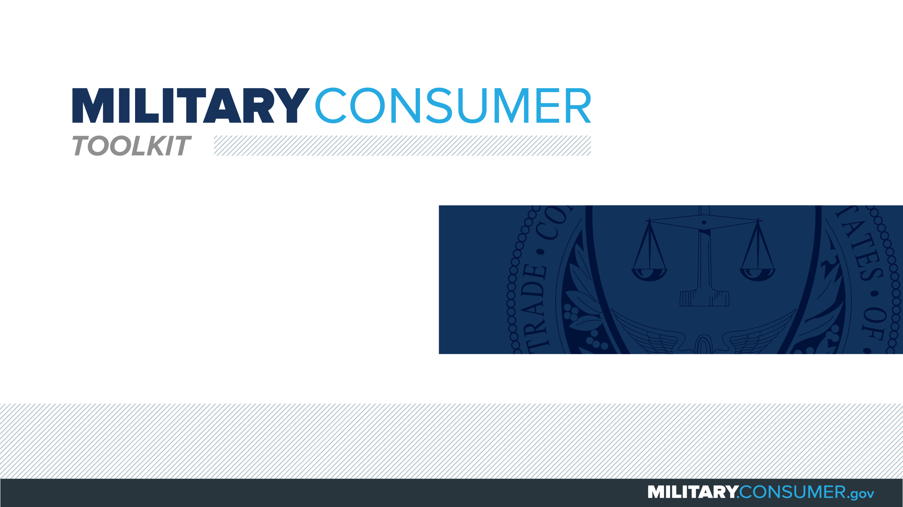

Slide 2
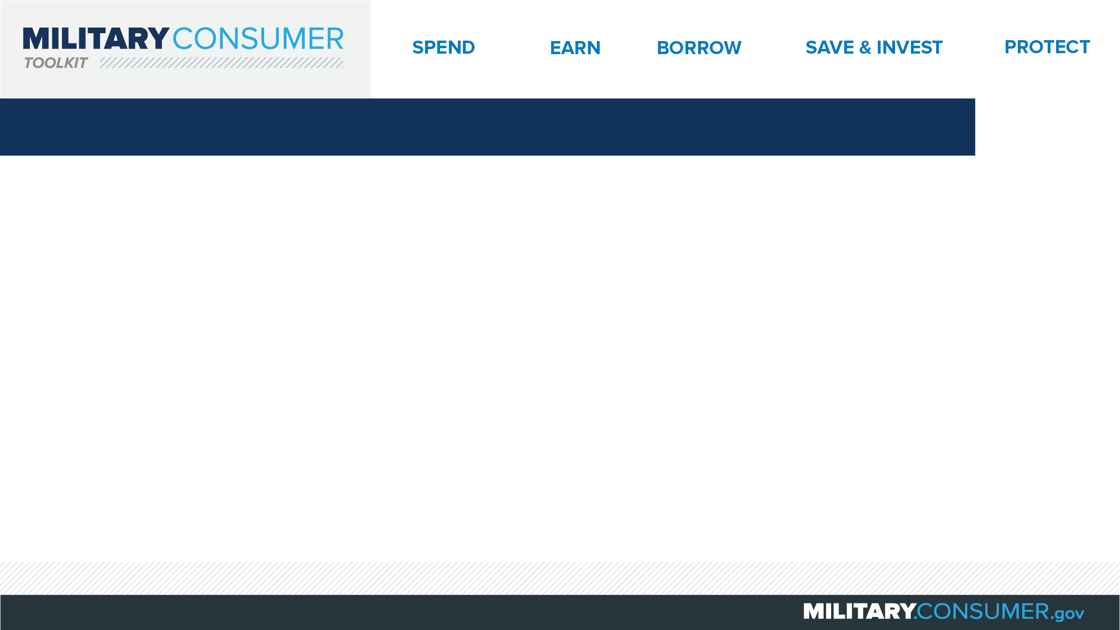
Why This Matters
Studies show that, on average, military families have higher amounts of debt and fewer assets than civilians
Challenges of military life can affect servicemembers’ finances:
  Frequent transition and changes
  Many servicemembers have little financial experience
  Decisions have long-term effects
Getting the know-how is key to making smart financial decisions
Notes:
[Presenter: Use this slide to set up the rest of your presentation, following it with slides that focus on the specific topics you want to cover.]
Suggested Script:
Today I’d like to talk about financial readiness – why it’s important and what you need to know to achieve it.
According to the National Foundation for Credit Counseling, active members of the military, veterans and their families have higher amounts of credit card debt and fewer assets than civilians. This means that military families are less equipped than their civilian counterparts to have the money they need for a secure future.
This is caused by many factors. As you know, military life is full of events and transitions, and each of these events brings the need to make important financial decisions. Unfortunately, many servicemembers – especially those without much financial experience – lack the information they need to make the right choices. This is particularly scary because many of these decisions can have long-term effects on a servicemember’s security clearance, mission readiness and family life.
Understanding your finances is your first line of defense. That’s why I’m here today – to help provide you with practical tips and information that will help you feel prepared to make these critical decisions.

Slide 3
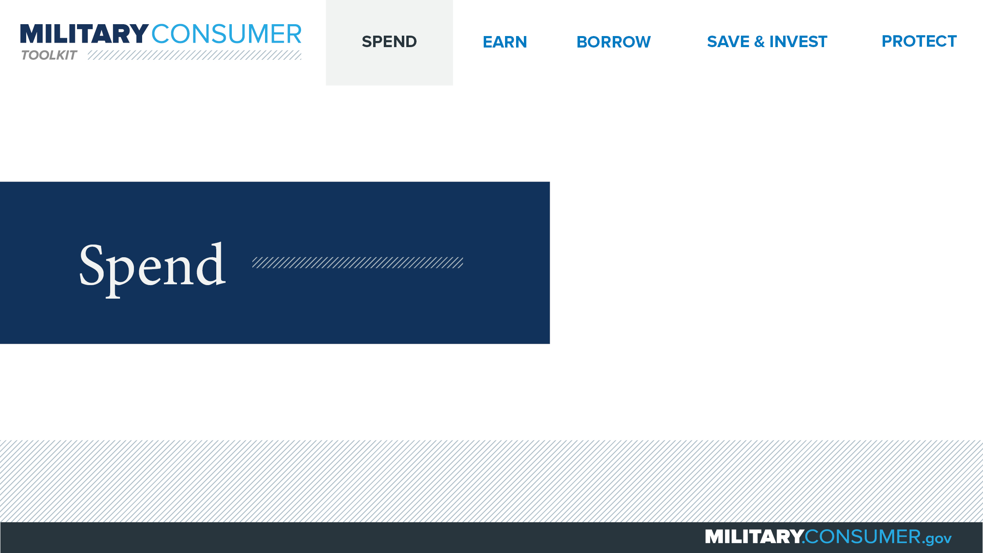
Notes:
Suggested Script:
Spending money is a fact of life. But it’s best to do this in a way that is carefully researched and planned out. When you know where your money is going, you have the power.
Today, we will learn about [PRESENTER: CUSTOMIZE TO SUIT THE TOPICS YOU WILL COVER] people who are available to help you plan your spending, how to create and manage a budget and how to shop smart for purchases ranging from small to large.

Slide 4
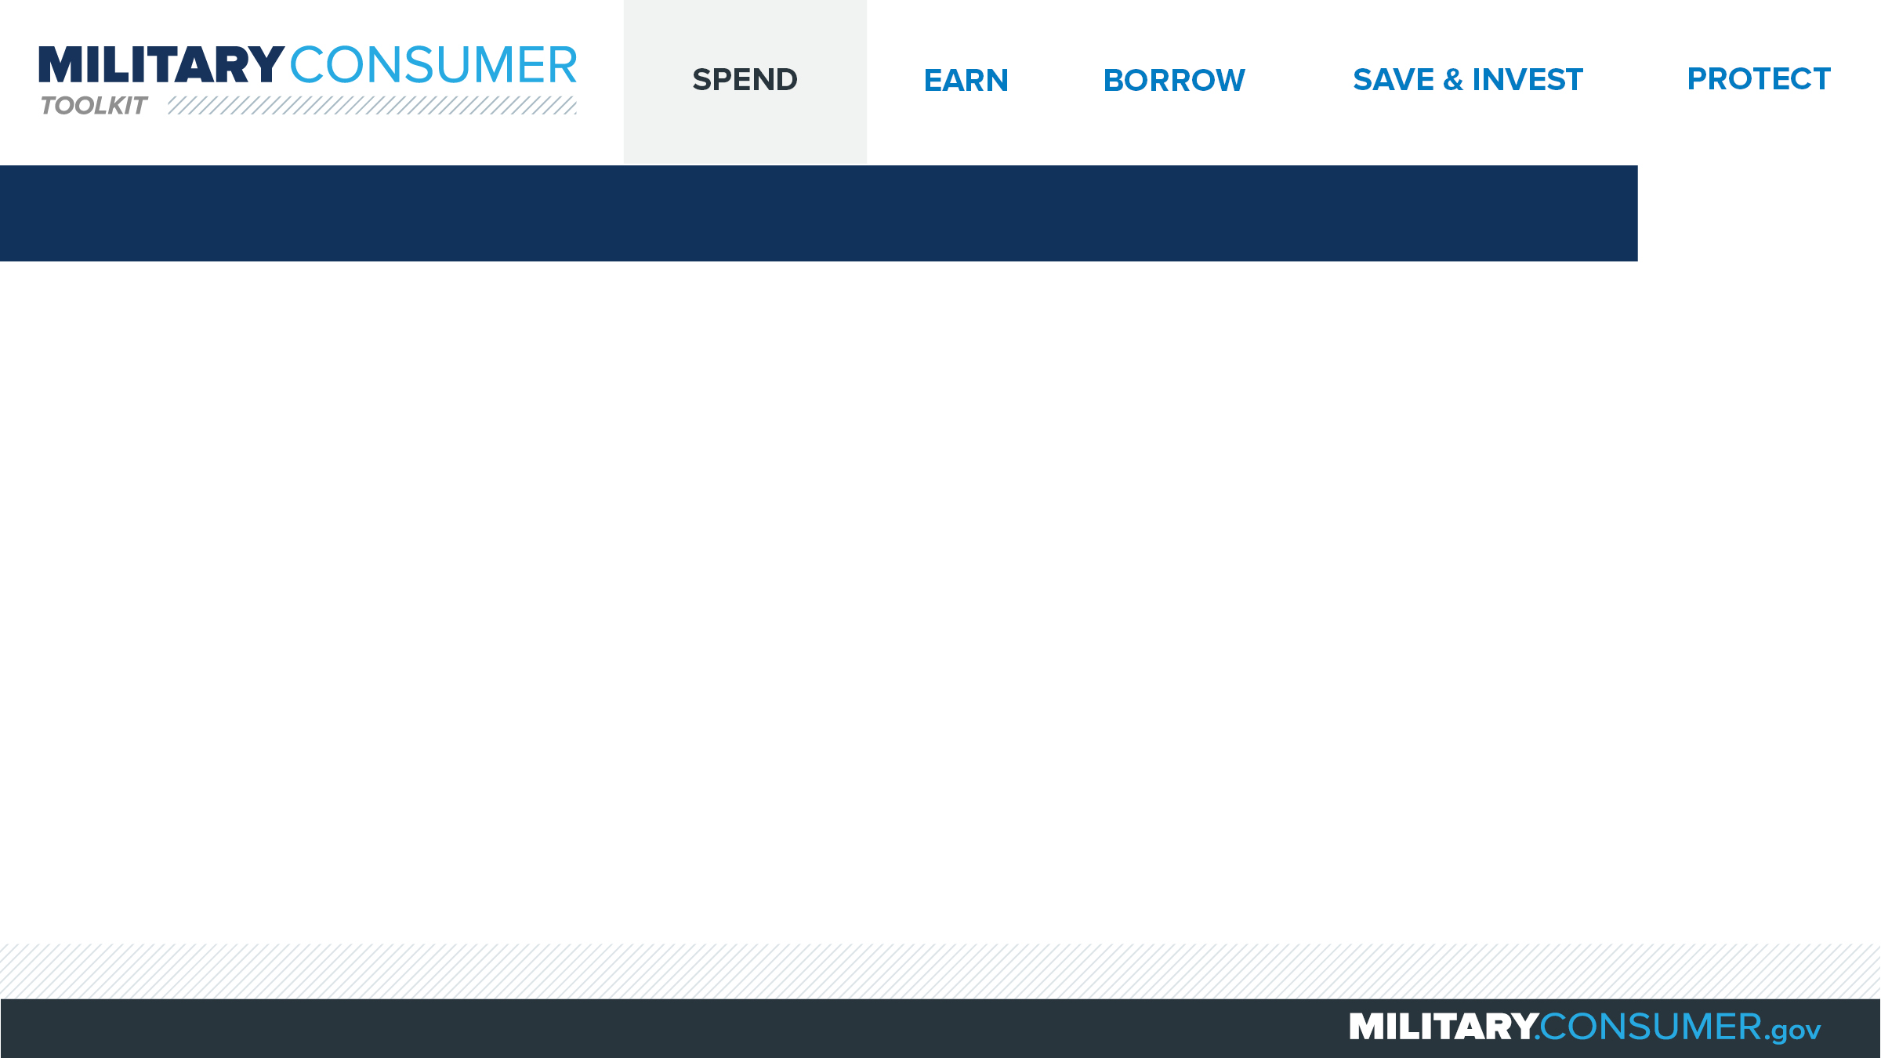
Using Allotments
Payments deducted before you receive your paycheck
  Can be used to pay for things like life insurance or military loans
  Can not be used to pay for things like cars or furniture
Two types
  Discretionary
  Non-discretionary
PFM can help with
  Eligibility
  Fitting allotments into budget
  Planning for financial goals
Notes:
Suggested Script:
How many of you have heard of allotments?
Allotments are a way to pay for things directly from your paycheck – before you see the money. Servicemembers often use them to pay for things like life insurance or repaying military loans. They can not be used to pay for things like vehicles, furniture, electronics and jewelry.
There are two types of allotments:
You can set up to six discretionary allotments, which are payments to non-government organizations. For example, you could use a discretionary allotment to send money directly to your bank for your savings account.
You can set up to 15 non-discretionary allotments, which are payments to the government for things like savings bonds. Sometimes, the government might set these up for you to pay overdue taxes or loans from military relief agencies.
This may sound confusing. Fortunately, your Personal Financial Manager (PFM) can help you with allotments. First, your PFM will help you determine if you’re eligible – allotments are typically available to active duty service members, midshipmen, cadets, reservists on EAD and retirees. If you are eligible, your PFM will help you decide how many allotments make sense for your budget and how you can use them for short and long-term financial planning.

Slide 5


